Slide 1

Optimizing Inventory for Growth
🧠 Smart inventory = 😊 happier customers, fewer costs, and ✅ smoother operations.
T. T Inc
Innovating the Future of Technology

Slide 2
Inventory Optimization Challenges
⚖️ Optimize inventory (reduce over/understock)
😃 Ensure product availability
📊 Use data for smarter decisions

Slide 3
📊 Sales Performance: Best & Least-Selling Products
Key Insights:
🔼 Top-Selling Products 📈 → Prioritize restocking
🔽 Lowest-Selling Products 📉 → Evaluate promotions/discontinuation

Slide 4
🏆 Best-Selling Product Category
Key Insight:
📌 Home Appliances had the highest sales volume.
Recommendations:
🔹 📦 Stock more.
🔹 🧠 Study customer trends
🔹 💡 Promotions
🔹 🏷 Track prices

Slide 5
📊 Economic Influence on Sales (Inflation & GDP)
“Inflation & GDP had minimal to weak correlation with sales. Focus should remain on promotions and seasonality.”
Factor | Impact on Sales | Action Plan
Inflation | Weak negative correlation | Adjust pricing strategies
GDP | Minimal effect | Focus on promotions

Slide 6
📊 Promotions Impact on Sales
Key Insights:
Category | Sales_with_Promotion | Sales_without_Promotion | Impact
Home_Appliances | ✅ Higher Sales | 📉 Lower Sales | Effective
Electronics | 📉 Lower Sales | ✅ Higher Sales | Not Effective
Laptops | 📉 Lower Sales | ✅ Higher Sales | Not Effective
SmartPhones | 📉 Lower Sales | ✅ Higher Sales | Not Effective
Recommendations:
🎯 Targeted Promotions → Improve underperforming products.
🧑‍🤝‍🧑 Customer Behavior → Track promotion effectiveness.
🔬 A/B Testing → Optimize discount strategies.
💲 Dynamic Pricing → Adjust based on demand shifts.

Slide 7
📊 Average Sales Quantity per Category
Key Insights:
Recommendations:
✅ Higher demand for Electronics → Stock prioritization.
✅ Close sales figures → Cross-category promotions.
✅ Balance inventory based on demand trends.

Slide 8
📊 Seasonal Factors Impact
Key Insights:
✅ Minimal seasonal impact—electronics lead in year-round demand.
📊 Laptops & Smartphones need non-seasonal growth strategies.
✅ Home Appliances Show Slight Seasonality: With a seasonal factor of 1.01, Home Appliances may have some seasonal variation but remain relatively stable.
📌 Recommendations for Inventory Management:
🔹 Prioritize high-demand categories (Electronics) in stock planning.
🔹 Monitor Home Appliances for seasonal fluctuations and adjust inventory accordingly.
🔹 Analyze external demand drivers (e.g., pricing strategies, promotions) for Laptops & Smartphones.
🔹 Shift focus from seasonality to demand forecasting for better inventory optimization.

Slide 9
📊 Average Sales & Promotions Impact
Key Insights:
Home Appliances: Highest average sales & most promotions
Smartphones: Lower avg. despite promotions
Recommendations:
✅ Increase targeted promotions for lower-selling categories (e.g., SmartPhones & Laptops).
✅ Analyze product-level performance to determine which promotions drive the highest sales lift.
✅ Optimize inventory levels for high-performing categories to prevent stockouts.
Product Category | Avg_Sales_Quantity | Promotion_Count
Home_Appliances | 54.13 | 220
Electronics | 52.35 | 212
SmartPhones | 49.26 | 212
Laptops | 49.64 | 219

Slide 10
Barriers to Effective Inventory Management
🔄 Demand Uncertainty – Fluctuating customer demand.
📅 Seasonality Effects – Some categories impacted by seasonality.
📉 Economic Factors – Inflation affects pricing.
🎯 Promotion Effectiveness – Some promotions work, others don't.

Slide 11
Data-Driven Inventory Insights
🏆 Top-Selling → Restock First
📉 Low Sales → Evaluate Promotions
📊 Restocking Decisions → Based on Demand Trends

Slide 12
Data-Backed Optimization Strategies
Economic Sensitivity 💰
Optimized
Inventory
Management
Inventory Automation 🤖
Demand Forecasting
Smart Inventory Planning
Forecasting Accuracy 📊
Monitor Stock Trends
Analyze Seasonal Demand
This strategy pyramid highlights the structured approach to inventory optimization, focusing on forecasting, automation, and economic sensitivity

Slide 13
Path to Inventory Efficiency
✅ Better stock levels → Fewer shortages
✅ Smarter promotions → Higher profits.
✅ Proactive planning → Meet demand shifts.
✅ Continuous monitoring → Smarter decisions.

Slide 14
Appendix SQL Queries

Slide 15
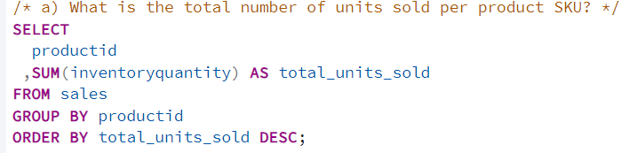
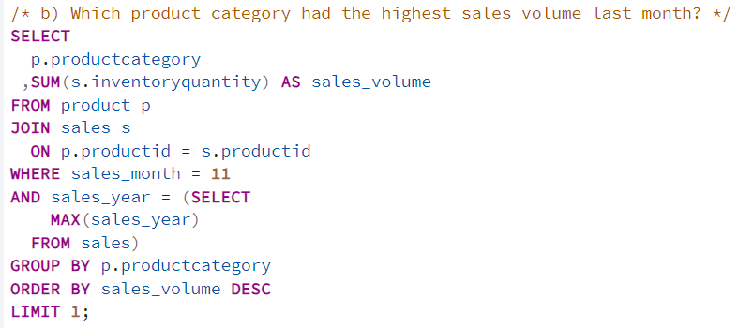
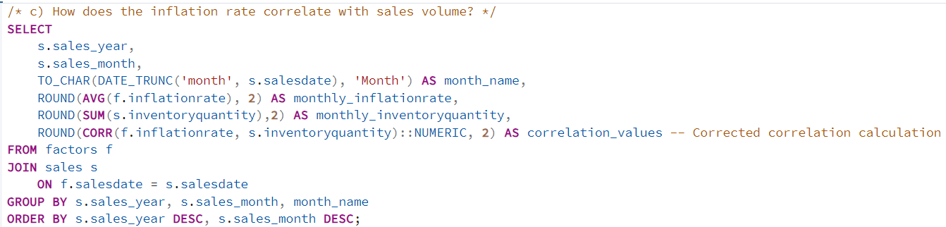

Slide 16
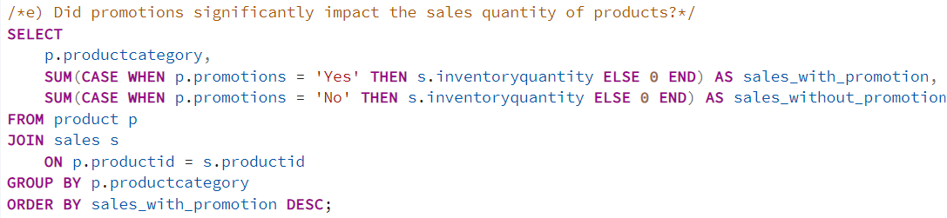
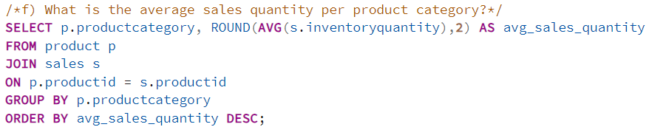
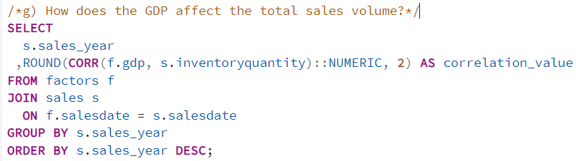

Slide 17
